Slide 1
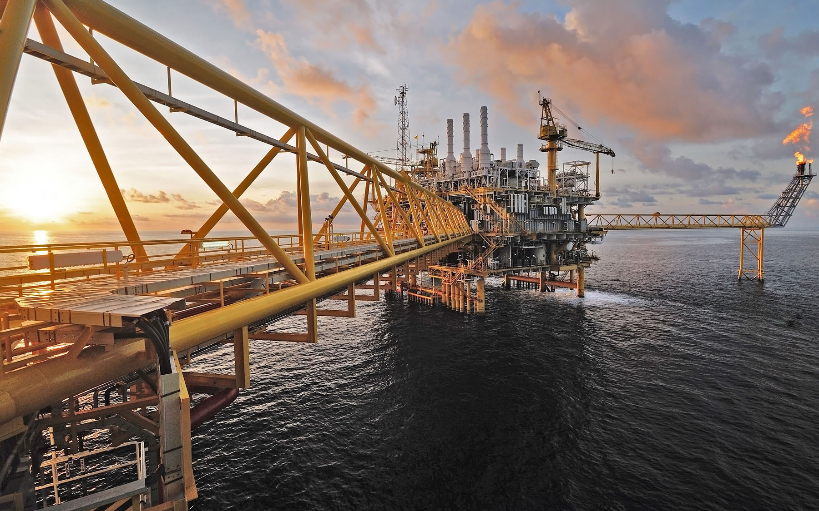


Structural Integrity Management System (SIMS) – Phase 1: Initiation
SIMS Dashboard Development
Badak LNG Plant Site, Bontang
PT. Badak NGL
Prepared by : WHC
Rev A / 20260701
PT. DINAMIKA TEKNIK PERSADA
Engineering Consultants
www.dtp-eng.com

Slide 2

Structural Integrity Management System (SIMS)
Sign in to start your session
User Name
Password
Rember Me
Sign in
Notes:
Halaman Sign in

Slide 3
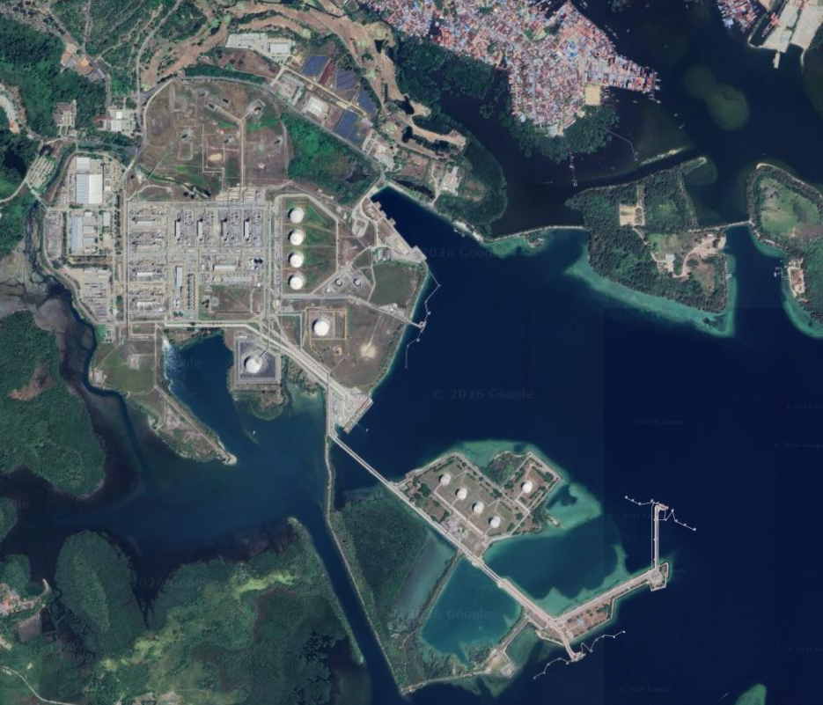
Structural Integrity Management System (SIMS)
Home
Asset Register
Risk Based Inspection Planning
Add
Module
Account Manager
Help
Logout
Asset Tree
Badak NGL
Summary
Summary
Summary
>Plant 1 Gas Purification Section
>Plant 2 Dehydration Section
>Plant 3 Fractionation Section
>Plant 4 Refrigeration Section
>Plant 5 Liquefaction Section
>Plant 6 Condensate Stripping ...
>Plant 15 LPG Section
>Plant 16 Condensate Stabilize ...
>Plant 17 LPG Storage and Loa …
>Plant 19 Relief & Blowdown S …
>Plant 20 Condensate Storage ...
20D-4/Q-1
20D-5/Q-1
20D-6/Q-1
+ add asset
>Plant 21 Feed Gas Knockout …
>Plant 22 Marine Structures
>Plant 24 LNG Storage and Loa …
>Plant 25 Fueling Facility
>Plant 26 LPG Filling Station … >Propane and Butane
>Plant 27 Oxygen Plant
>Plant 28 Acetylene Plant
>Plant 29 Nitrogen Generation
>Plant 30 Electrical Distributio …
>Plant 31 Steam & Power Gen …
>Plant 32 Seawater Cooling …
>Plant 33 Fire Protection System
>Plant 34 Liquid Waste System
>Plant 35 Compressed Air System
>Plant 36 Water Treatment Sy …
>Plant 37 Communication
>Plant 38 Inter-connecting
+ add Plant
All Plant
500
300
200
100
Good Fair Poor Unknown
Plant Summary
Plant 1
Plant 2
Plant 3
Plant 4
Plant 5
Plant 6
Plant 7
Plant 8
Plant 9
Plant 10
415
927
17
19
200
7
2
175
10
17
430
430
430
12
Notes:
Halaman dashboard
Action: N/A

Slide 4
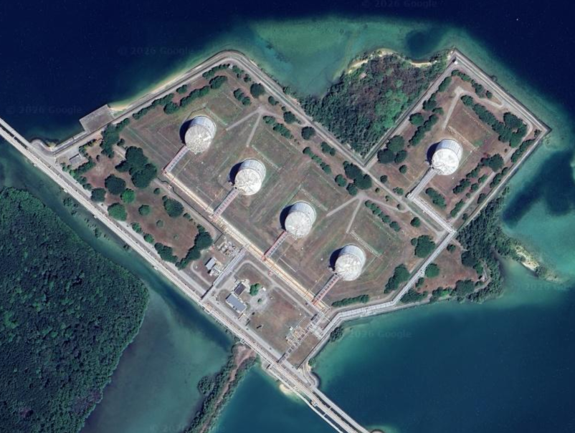

Structural Integrity Management System (SIMS)
Home
Asset Register
Risk Based Inspection Planning
Add
Module
Account Manager
Help
Logout
Asset Tree
Plant 17: LPG Storage and Loading
Description
Summary
>Plant 1 Gas Purification Section
>Plant 2 Dehydration Section
>Plant 3 Fractionation Section
>Plant 4 Refrigeration Section
>Plant 5 Liquefaction Section
>Plant 6 Condensate Stripping ...
>Plant 15 LPG Section
>Plant 16 Condensate Stabilize ...
>Plant 17 LPG Storage and Loa …
17D-1/Q-1
17D-2/Q-1
17D-3/Q-1
17D-4/Q-1
17D-5/Q-1
+ add asset
>Plant 19 Relief & Blowdown S …
>Plant 20 Condensate Storage ...
20D-4/Q-1
20D-5/Q-1
20D-6/Q-1
+ add asset
>Plant 21 Feed Gas Knockout …
>Plant 22 Marine Structures
>Plant 24 LNG Storage and Loa …
>Plant 25 Fueling Facility
>Plant 26 LPG Filling Station … >Propane and Butane
>Plant 27 Oxygen Plant
>Plant 28 Acetylene Plant
>Plant 29 Nitrogen Generation
>Plant 30 Electrical Distributio …
>Plant 31 Steam & Power Gen …
>Plant 32 Seawater Cooling …
>Plant 33 Fire Protection System
>Plant 34 Liquid Waste System
>Plant 35 Compressed Air System
>Plant 36 Water Treatment Sy …
>Plant 37 Communication
+ add Plant
Summary
Plant Code | 17
Plant Desc. | LPG Storage and Loading
17D-4/Q-1
17D-5/Q-1
17D-3/Q-1
17D-2/Q-1
17D-1/Q-1
Notes:
Halaman Dashboard
Action: Klik Spesfik Plant pada Asset Tree

Slide 5
Structural Integrity Management System (SIMS)
Home
Asset Register
Risk Based Inspection Planning
Add
Module
Account Manager
Help
Logout
Asset Tree
17D-1/Q-1
Description
Summary
>Plant 1 Gas Purification Section
>Plant 2 Dehydration Section
>Plant 3 Fractionation Section
>Plant 4 Refrigeration Section
>Plant 5 Liquefaction Section
>Plant 6 Condensate Stripping ...
>Plant 15 LPG Section
>Plant 16 Condensate Stabilize ...
>Plant 17 LPG Storage and Loa …
17D-1/Q-1
17D-2/Q-1
17D-3/Q-1
17D-4/Q-1
17D-5/Q-1
+ add asset
>Plant 19 Relief & Blowdown S …
>Plant 20 Condensate Storage ...
20D-4/Q-1
20D-5/Q-1
20D-6/Q-1
+ add asset
>Plant 21 Feed Gas Knockout …
>Plant 22 Marine Structures
>Plant 24 LNG Storage and Loa …
>Plant 25 Fueling Facility
>Plant 26 LPG Filling Station … >Propane and Butane
>Plant 27 Oxygen Plant
>Plant 28 Acetylene Plant
>Plant 29 Nitrogen Generation
>Plant 30 Electrical Distributio …
>Plant 31 Steam & Power Gen …
>Plant 32 Seawater Cooling …
>Plant 33 Fire Protection System
>Plant 34 Liquid Waste System
>Plant 35 Compressed Air System
>Plant 36 Water Treatment Sy …
>Plant 37 Communication
+ add Plant
Summary
Asset register No. | 1
GIS Ref. No. | 1234567890
Asset tag no. | 17D-1/Q-1
Asset Description | Foundation for 17D-1
Zone | Zone 1
Area | LPG Storage and Loading
Train | -
Coordinate | 1234567890 N | 1234567890 E
Installed | 1970 (age: 56 years)
Condition | Good
QR Code | http:www.dtp-eng.com |  | Preview
17D-1/Q-1
Asset Details
Notes:
Action: Klik Spesifik Asset pada Asset Tree
←||→ : Geser window

Slide 6
Tabel Description
Mengambil/memanggil data Asset details > Asset register dan Asset details > Condition (GVI)
Asset details > Asset Register
Asset Register
Asset register No. | 1
GIS Ref. No. | 1234567890
Asset tag no. | 17D-1/Q-1
Plant code | 17 | LPG Storage and Loading
Equipment code | D | Tanks
Equipment desc. | Propane tank
Equipment order | 1
Civil asset code | Q | Foundation
Civil asset Order | 1
Civil asset desc. | Foundation for 17D-1
QR Code | http: www.dtp-eng.com | ↑ |  | Preview
Asset Attribute
Function | Equipment foundation
Material | Reinforced concrete
Year Installed | 1970 (age: 56 year)
Owner | PT. Badak NGL
Constrain | N/A
Access | Road
Location
Coordinate | 1234567890 N |  | 1234567890 E
Zone | Zone 1
Area | LPG Storage and Loading
Train | N/A
Asset register No. | 1
GIS Ref. No. | 1234567890
Asset tag no. | 17D-1/Q-1
Asset Description | Foundation for 17D-1
Zone | Zone 1
Area | LPG Storage and Loading
Train | -
Coordinate | 1234567890 N | 1234567890 E
Installed | 1970 (age: 56 years)
Condition | Good
QR Code | http:www.dtp-eng.com |  | Preview
Asset details > Condition (GVI)
Date of Inspection | 15/Aug/2026
Inspector | James Bond
Condition | Good
Comment | Structure is in good condition Minor coating degradation
Preview

Slide 7
Structural Integrity Management System (SIMS)
Home
Asset Register
Risk Based Inspection Planning
Add
Module
Account Manager
Help
Logout
Asset Tree
17D-1/Q-1
Asset Register | Condition (GVI) | Inspection | Risk Based Inspection | Technical Document | Documentation | Name Plate
>Plant 1 Gas Purification Section
>Plant 2 Dehydration Section
>Plant 3 Fractionation Section
>Plant 4 Refrigeration Section
>Plant 5 Liquefaction Section
>Plant 6 Condensate Stripping ...
>Plant 15 LPG Section
>Plant 16 Condensate Stabilize ...
>Plant 17 LPG Storage and Loa …
17D-1/Q-1
17D-2/Q-1
17D-3/Q-1
17D-4/Q-1
17D-5/Q-1
+ add asset
>Plant 19 Relief & Blowdown S …
>Plant 20 Condensate Storage ...
20D-4/Q-1
20D-5/Q-1
20D-6/Q-1
+ add asset
>Plant 21 Feed Gas Knockout …
>Plant 22 Marine Structures
>Plant 24 LNG Storage and Loa …
>Plant 25 Fueling Facility
>Plant 26 LPG Filling Station … >Propane and Butane
>Plant 27 Oxygen Plant
>Plant 28 Acetylene Plant
>Plant 29 Nitrogen Generation
>Plant 30 Electrical Distributio …
>Plant 31 Steam & Power Gen …
>Plant 32 Seawater Cooling …
>Plant 33 Fire Protection System
>Plant 34 Liquid Waste System
>Plant 35 Compressed Air System
>Plant 36 Water Treatment Sy …
>Plant 37 Communication
+ add Plant
Asset Register
Asset register No. | 1
GIS Ref. No. | 1234567890
Asset tag no. | 17D-1/Q-1
Plant code | 17 | LPG Storage and Loading
Equipment code | D | Tanks
Equipment desc. | Propane tank
Equipment order | 1
Civil asset code | Q | Foundation
Civil asset Order | 1
Civil asset desc. | Foundation for 17D-1
QR Code | http: www.dtp-eng.com | ↑ |  | Preview
Asset Attribute
Function | Equipment foundation
Material | Reinforced concrete
Year Installed | 1970 (age: 56 year)
Owner | PT. Badak NGL
Constrain | N/A
Access | Road
Location
Coordinate | 1234567890 N |  | 1234567890 E
Zone | 1
Area | LPG Storage and Loading
Train | N/A
Edit
Notes:
Action: Klik Asset Details dari halaman sebelumnya

Slide 8
Structural Integrity Management System (SIMS)
Home
Asset Register
Risk Based Inspection Planning
Add
Module
Account Manager
Help
Logout
Asset Tree
17D-1/Q-1
Asset Register | Condition (GVI) | Inspection | Risk Based Inspection | Technical Document | Documentation | Name Plate
>Plant 1 Gas Purification Section
>Plant 2 Dehydration Section
>Plant 3 Fractionation Section
>Plant 4 Refrigeration Section
>Plant 5 Liquefaction Section
>Plant 6 Condensate Stripping ...
>Plant 15 LPG Section
>Plant 16 Condensate Stabilize ...
>Plant 17 LPG Storage and Loa …
17D-1/Q-1
17D-2/Q-1
17D-3/Q-1
17D-4/Q-1
17D-5/Q-1
+ add asset
>Plant 19 Relief & Blowdown S …
>Plant 20 Condensate Storage ...
20D-4/Q-1
20D-5/Q-1
20D-6/Q-1
+ add asset
>Plant 21 Feed Gas Knockout …
>Plant 22 Marine Structures
>Plant 24 LNG Storage and Loa …
>Plant 25 Fueling Facility
>Plant 26 LPG Filling Station … >Propane and Butane
>Plant 27 Oxygen Plant
>Plant 28 Acetylene Plant
>Plant 29 Nitrogen Generation
>Plant 30 Electrical Distributio …
>Plant 31 Steam & Power Gen …
>Plant 32 Seawater Cooling …
>Plant 33 Fire Protection System
>Plant 34 Liquid Waste System
>Plant 35 Compressed Air System
>Plant 36 Water Treatment Sy …
>Plant 37 Communication
+ add Plant
Asset Register
Asset register No. | <auto numbering>
GIS Ref. No. | <number>
Asset tag no. | <auto generate tag number>
Plant code | <Plant code selection> | <Look up plant code>
Equipment code | <Equipment code selection> | <Look up equipment code>
Equipment desc. | <Text>
Equipment order | <Text>
Civil asset code | <Civil asset code selection> | <Look up civil asset code>
Civil asset desc. | <text>
Civil asset Order | <number>
QR Code | <text> |  |  | <Select file>
Asset Attribute
Function | <Function selection>
Material | <Material selection>
Year Installed | <Number>
Owner | <Text>
Constrain | <Text>
Access | <Access selection>
Location
Coordinate | <Number> N |  | <Number> E
Zone | <Number>
Area | <Text>
Train | <Text>
Save
Notes:
Action: Klik Edit pada halaman sebelumnya

Slide 9
Label : Asset Tag No.
Feature: : Auto generate tag number
Formula:
=concat
<Plant code> <Equipment Code> ”-” <Equipment Order> “/” <Civil Asset Code> “-” <Civil Asset Order>
Result Example:
17D-5/Q-1
Asset Register
Asset register No.
GIS Ref. No.
Asset tag no. | <auto generate tag number>
Plant code | 17
Equipment code | D
Equipment desc.
Equipment order | 5
Civil asset code | Q
Civil asset Order | 1
Civil asset desc.
QR Code

Slide 10
Plant Code Selection | Description
1 | Gas Purification Section
2 | Dehydration Section
3 | Fractionation Section
4 | Refrigeration Section
5 | Liquifaction Section
6 | Condensate Stripping Section
15 | LPG Section
16 | Condensate Stabilizer Section
17 | LPG Storage and Loading
19 | Relief & Blowdown System
20 | Condensate Storage and Process LPG Storage
21 | Feed Gas Knockout Drum
22 | Marine Structures
24 | LNG Storage and Loading Facility
25 | Fueling Facility
26 | LPG Filling Station for Propane and Butane
27 | Oxygen Plant
28 | Acetylene Plant
29 | Nitrogen Generation
30 | Electrical Distribution Facilities
31 | Steam & Power Generation
32 | Seawater Cooling System
33 | Fire Protectuon System
34 | Liquid Waste System
35 | Compressed Air System
36 | Water Treatment System
37 | Communication
38 | Inter-connecting Pipeways
39 | Nitrogen Plant (Expansion)
40 | Site Preparation
41 | Buildings
42 | Building Equipment
43 | Tug Boats
48 | Community Facilities
49 | Community Facilities
50 | Plot Plans
51 | Mobile Equipment
52 | Distributed Control System
53 | Machinery Monitroing System
55 | Maps
57 | New 36 inch Pipeline
58 | 36 inch pipeline
59 | 42 inch pipeline
60 | 20 inch pipeline
61 | 16 inch pipeline
62 | 16 inch pipeline
63 | 6 inch pipeline
64 | Water Recreation Facilities
70 | Outside PT. Badak NGL Area
Label : Plant Code
Feature: : Drop Down Selection and Look Up
Asset Register
Asset register No.
GIS Ref. No.
Asset tag no.
Plant code | <Plant code Selection> | <Look up plant code>
Equipment code
Equipment desc.
Equipment order
Civil asset code
Civil asset Order
Civil asset desc.
QR Code
Example
Asset Register
Asset register No.
GIS Ref. No.
Asset tag no.
Plant code | 17 | LPG Storage and Loading
Equipment code
Equipment desc.
Equipment order
Civil asset code
Civil asset Order
Civil asset desc.
QR Code

Slide 11
Equipment Code Selection | Description
A | General
B | Process
C | Pressure Vessels
D | Tanks
E | Heat Exchangers
EM | Fan Motor
F | Fired Heaters
FX | Flame ignitor
G | Pumps
GA | Air motor driver for Pump
GE | Diesel Engine for Pump
GM | Electric Motor Driver for Pump
GT | Gas turbine
H | Vacuum
J | Instruments
KE | Diesel Engine Driver for Compressor
KG | Gear
KM | Electric Motor for Compressor
KT | Gas Turbine Driver for Compressor
KTM | Turning motor for compressor
KX | Clutch
L | Piping
LM | Motor for Valves
N | Insulation
P | Electrical
PD | Battreies
PE | Diesel Engine Driver for Turbine generator
PG | Steam and Gas Turbine Generators
PGR | Ground System
PH | Electric Heater
PM | Motor control center for switchgear
PS | Switchgear
PSW | Primary Switch
PT | Transformer
PU | UPS Units
PUT | UPS Transformer
PY | Battery Charger
T | Material Handling Equipment
TM | Electric Motor for material handling equipment
TX | Bearing for material handling equipment
U | Expandables
V | Package Units
VG | Pump for package unit
VO | Valve Operators
VM | Electric Motor for Package Units
W | Welding and Metal Processing
X | Painting
Y | Processing
YM | Electric Motor for Processing Equipment
YX | Cylinder positioner driver for starting air system
Z | Water treating equipment
Label : Equipment Code
Feature: : Drop Down Selection and Look Up
Asset Register
Asset register No.
GIS Ref. No.
Asset tag no.
Plant code | <Plant code Selection> | <Look up plant code>
Equipment code | <Equipment code Selection> | <Look up Equipment Code>
Equipment desc.
Equipment order
Civil asset code
Civil asset Order
Civil asset desc.
QR Code
Example
Asset Register
Asset register No.
GIS Ref. No.
Asset tag no.
Plant code
Equipment code | D | Tanks
Equipment desc.
Equipment order
Civil asset code
Civil asset Order
Civil asset desc.
QR Code

Slide 12
Label : Civil Asset Code
Feature: : Drop Down Selection and Look Up
Asset Register
Asset register No.
GIS Ref. No.
Asset tag no.
Plant code
Equipment code
Equipment desc.
Equipment order
Civil asset code | <Civil asset code selection> | <Look up Civil asset code>
Civil asset Order
Civil asset desc.
QR Code
Civil Asset Code Selection | Description
M | Structure
Q | Foundation
R | Buildings
S | Site Improvement
Example
Asset Register
Asset register No.
GIS Ref. No.
Asset tag no.
Plant code
Equipment code
Equipment desc.
Equipment order
Civil asset code | Q | Foundation
Civil asset Order
Civil asset desc.
QR Code

Slide 13
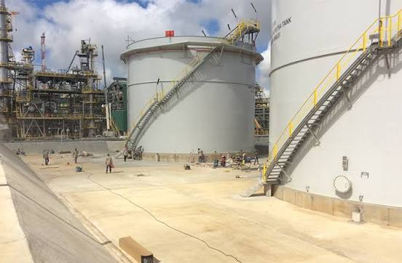

Structural Integrity Management System (SIMS)
Home
Asset Register
Risk Based Inspection Planning
Add
Module
Account Manager
Help
Logout
Asset Tree
17D-1/Q-1
Asset Register | Condition (GVI) | Inspection | Risk Based Inspection | Technical Document | Documentation | Name Plate
>Plant 1 Gas Purification Section
>Plant 2 Dehydration Section
>Plant 3 Fractionation Section
>Plant 4 Refrigeration Section
>Plant 5 Liquefaction Section
>Plant 6 Condensate Stripping ...
>Plant 15 LPG Section
>Plant 16 Condensate Stabilize ...
>Plant 17 LPG Storage and Loa …
17D-1/Q-1
17D-2/Q-1
17D-3/Q-1
17D-4/Q-1
17D-5/Q-1
+ add asset
>Plant 19 Relief & Blowdown S …
>Plant 20 Condensate Storage ...
20D-4/Q-1
20D-5/Q-1
20D-6/Q-1
+ add asset
>Plant 21 Feed Gas Knockout …
>Plant 22 Marine Structures
>Plant 24 LNG Storage and Loa …
>Plant 25 Fueling Facility
>Plant 26 LPG Filling Station … >Propane and Butane
>Plant 27 Oxygen Plant
>Plant 28 Acetylene Plant
>Plant 29 Nitrogen Generation
>Plant 30 Electrical Distributio …
>Plant 31 Steam & Power Gen …
>Plant 32 Seawater Cooling …
>Plant 33 Fire Protection System
>Plant 34 Liquid Waste System
>Plant 35 Compressed Air System
>Plant 36 Water Treatment Sy …
>Plant 37 Communication
+ add Plant
Date of Inspection | 15/Aug/2026
Inspector | James Bond
Condition | Good
Comment | Structure is in good condition Minor coating degradation
Preview
Edit
3 o/c Position

Slide 14
Structural Integrity Management System (SIMS)
Home
Asset Register
Risk Based Inspection Planning
Add
Module
Account Manager
Help
Logout
Asset Tree
17D-1/Q-1
Asset Register | Condition (GVI) | Inspection | Risk Based Inspection | Technical Document | Documentation | Name Plate
>Plant 1 Gas Purification Section
>Plant 2 Dehydration Section
>Plant 3 Fractionation Section
>Plant 4 Refrigeration Section
>Plant 5 Liquefaction Section
>Plant 6 Condensate Stripping ...
>Plant 15 LPG Section
>Plant 16 Condensate Stabilize ...
>Plant 17 LPG Storage and Loa …
17D-1/Q-1
17D-2/Q-1
17D-3/Q-1
17D-4/Q-1
17D-5/Q-1
+ add asset
>Plant 19 Relief & Blowdown S …
>Plant 20 Condensate Storage ...
20D-4/Q-1
20D-5/Q-1
20D-6/Q-1
+ add asset
>Plant 21 Feed Gas Knockout …
>Plant 22 Marine Structures
>Plant 24 LNG Storage and Loa …
>Plant 25 Fueling Facility
>Plant 26 LPG Filling Station … >Propane and Butane
>Plant 27 Oxygen Plant
>Plant 28 Acetylene Plant
>Plant 29 Nitrogen Generation
>Plant 30 Electrical Distributio …
>Plant 31 Steam & Power Gen …
>Plant 32 Seawater Cooling …
>Plant 33 Fire Protection System
>Plant 34 Liquid Waste System
>Plant 35 Compressed Air System
>Plant 36 Water Treatment Sy …
>Plant 37 Communication
+ add Plant
Date of Inspection | <Date>
Inspector | <Text>
Condition | <Condition Selection>
Comment | <Text>
Save
Description | File
<Text> | <Select file>
Add File

Slide 15
Label : Condition
Feature: : Drop Down Selection and color code
Date of Inspection | <Date>
Inspector | <Text>
Condition | <Condition Selection>
Comment | <Text>
Condition Selection | Color Code
Good
Fair
Poor

Slide 16

Structural Integrity Management System (SIMS)
Home
Asset Register
Account Manager
Help
Logout
Asset Tree
17D-1/Q-1
Asset Register | Condition (GVI) | Inspection | Risk Based Inspection | Technical Document | Documentation | Name Plate
>Plant 1 Gas Purification Section
>Plant 2 Dehydration Section
>Plant 3 Fractionation Section
>Plant 4 Refrigeration Section
>Plant 5 Liquefaction Section
>Plant 6 Condensate Stripping ...
>Plant 15 LPG Section
>Plant 16 Condensate Stabilize ...
>Plant 17 LPG Storage and Loa …
17D-1/Q-1
17D-2/Q-1
17D-3/Q-1
17D-4/Q-1
17D-5/Q-1
+ add asset
>Plant 19 Relief & Blowdown S …
>Plant 20 Condensate Storage ...
20D-4/Q-1
20D-5/Q-1
20D-6/Q-1
+ add asset
>Plant 21 Feed Gas Knockout …
>Plant 22 Marine Structures
>Plant 24 LNG Storage and Loa …
>Plant 25 Fueling Facility
>Plant 26 LPG Filling Station … >Propane and Butane
>Plant 27 Oxygen Plant
>Plant 28 Acetylene Plant
>Plant 29 Nitrogen Generation
>Plant 30 Electrical Distributio …
>Plant 31 Steam & Power Gen …
>Plant 32 Seawater Cooling …
>Plant 33 Fire Protection System
>Plant 34 Liquid Waste System
>Plant 35 Compressed Air System
>Plant 36 Water Treatment Sy …
>Plant 37 Communication
+ add Plant
Module Locked
Notes:
Inspection Module: Unlocked in the next project phase

Slide 17
Structural Integrity Management System (SIMS)
Home
Asset Register
Account Manager
Help
Logout
Asset Tree
17D-1/Q-1
Asset Register | Condition (GVI) | Inspection | Risk Based Inspection | Technical Document | Documentation | Name Plate
>Plant 1 Gas Purification Section
>Plant 2 Dehydration Section
>Plant 3 Fractionation Section
>Plant 4 Refrigeration Section
>Plant 5 Liquefaction Section
>Plant 6 Condensate Stripping ...
>Plant 15 LPG Section
>Plant 16 Condensate Stabilize ...
>Plant 17 LPG Storage and Loa …
17D-1/Q-1
17D-2/Q-1
17D-3/Q-1
17D-4/Q-1
17D-5/Q-1
+ add asset
>Plant 19 Relief & Blowdown S …
>Plant 20 Condensate Storage ...
20D-4/Q-1
20D-5/Q-1
20D-6/Q-1
+ add asset
>Plant 21 Feed Gas Knockout …
>Plant 22 Marine Structures
>Plant 24 LNG Storage and Loa …
>Plant 25 Fueling Facility
>Plant 26 LPG Filling Station … >Propane and Butane
>Plant 27 Oxygen Plant
>Plant 28 Acetylene Plant
>Plant 29 Nitrogen Generation
>Plant 30 Electrical Distributio …
>Plant 31 Steam & Power Gen …
>Plant 32 Seawater Cooling …
>Plant 33 Fire Protection System
>Plant 34 Liquid Waste System
>Plant 35 Compressed Air System
>Plant 36 Water Treatment Sy …
>Plant 37 Communication
+ add Plant
Module Locked
Notes:
Risk Based Inspection Module: Unlocked in the next project phase

Slide 18
Structural Integrity Management System (SIMS)
Home
Asset Register
Account Manager
Help
Logout
Asset Tree
17D-1/Q-1
Asset Register | Condition (GVI) | Inspection | Risk Based Inspection | Technical Document | Documentation | Name Plate
>Plant 1 Gas Purification Section
>Plant 2 Dehydration Section
>Plant 3 Fractionation Section
>Plant 4 Refrigeration Section
>Plant 5 Liquefaction Section
>Plant 6 Condensate Stripping ...
>Plant 15 LPG Section
>Plant 16 Condensate Stabilize ...
>Plant 17 LPG Storage and Loa …
17D-1/Q-1
17D-2/Q-1
17D-3/Q-1
17D-4/Q-1
17D-5/Q-1
+ add asset
>Plant 19 Relief & Blowdown S …
>Plant 20 Condensate Storage ...
20D-4/Q-1
20D-5/Q-1
20D-6/Q-1
+ add asset
>Plant 21 Feed Gas Knockout …
>Plant 22 Marine Structures
>Plant 24 LNG Storage and Loa …
>Plant 25 Fueling Facility
>Plant 26 LPG Filling Station … >Propane and Butane
>Plant 27 Oxygen Plant
>Plant 28 Acetylene Plant
>Plant 29 Nitrogen Generation
>Plant 30 Electrical Distributio …
>Plant 31 Steam & Power Gen …
>Plant 32 Seawater Cooling …
>Plant 33 Fire Protection System
>Plant 34 Liquid Waste System
>Plant 35 Compressed Air System
>Plant 36 Water Treatment Sy …
>Plant 37 Communication
+ add Plant
Module Locked
Notes:
Technical Document Module: Unlocked in the next project phase

Slide 19
Structural Integrity Management System (SIMS)
Home
Asset Register
Account Manager
Help
Logout
Asset Tree
17D-1/Q-1
Asset Register | Condition (GVI) | Inspection | Risk Based Inspection | Technical Document | Documentation | Name Plate
>Plant 1 Gas Purification Section
>Plant 2 Dehydration Section
>Plant 3 Fractionation Section
>Plant 4 Refrigeration Section
>Plant 5 Liquefaction Section
>Plant 6 Condensate Stripping ...
>Plant 15 LPG Section
>Plant 16 Condensate Stabilize ...
>Plant 17 LPG Storage and Loa …
17D-1/Q-1
17D-2/Q-1
17D-3/Q-1
17D-4/Q-1
17D-5/Q-1
+ add asset
>Plant 19 Relief & Blowdown S …
>Plant 20 Condensate Storage ...
20D-4/Q-1
20D-5/Q-1
20D-6/Q-1
+ add asset
>Plant 21 Feed Gas Knockout …
>Plant 22 Marine Structures
>Plant 24 LNG Storage and Loa …
>Plant 25 Fueling Facility
>Plant 26 LPG Filling Station … >Propane and Butane
>Plant 27 Oxygen Plant
>Plant 28 Acetylene Plant
>Plant 29 Nitrogen Generation
>Plant 30 Electrical Distributio …
>Plant 31 Steam & Power Gen …
>Plant 32 Seawater Cooling …
>Plant 33 Fire Protection System
>Plant 34 Liquid Waste System
>Plant 35 Compressed Air System
>Plant 36 Water Treatment Sy …
>Plant 37 Communication
+ add Plant
Module Locked
Notes:
Documentation Module: Unlocked in the next project phase

Slide 20



Structural Integrity Management System (SIMS)
Home
Asset Register
Risk Based Inspection Planning
Add
Module
Account Manager
Help
Logout
Asset Tree
17D-1/Q-1
Asset Register | Condition (GVI) | Inspection | Risk Based Inspection | Technical Document | Documentation | Name Plate
>Plant 1 Gas Purification Section
>Plant 2 Dehydration Section
>Plant 3 Fractionation Section
>Plant 4 Refrigeration Section
>Plant 5 Liquefaction Section
>Plant 6 Condensate Stripping ...
>Plant 15 LPG Section
>Plant 16 Condensate Stabilize ...
>Plant 17 LPG Storage and Loa …
17D-1/Q-1
17D-2/Q-1
17D-3/Q-1
17D-4/Q-1
17D-5/Q-1
+ add asset
>Plant 19 Relief & Blowdown S …
>Plant 20 Condensate Storage ...
20D-4/Q-1
20D-5/Q-1
20D-6/Q-1
+ add asset
>Plant 21 Feed Gas Knockout …
>Plant 22 Marine Structures
>Plant 24 LNG Storage and Loa …
>Plant 25 Fueling Facility
>Plant 26 LPG Filling Station … >Propane and Butane
>Plant 27 Oxygen Plant
>Plant 28 Acetylene Plant
>Plant 29 Nitrogen Generation
>Plant 30 Electrical Distributio …
>Plant 31 Steam & Power Gen …
>Plant 32 Seawater Cooling …
>Plant 33 Fire Protection System
>Plant 34 Liquid Waste System
>Plant 35 Compressed Air System
>Plant 36 Water Treatment Sy …
>Plant 37 Communication
+ add Plant
Foundation
for 17D-1
Tag no.: 17D-1/Q-1
Print

Slide 21
Structural Integrity Management System (SIMS)
Home
Asset Register
Risk Based Inspection Planning
Add
Module
Account Manager
Help
Logout
Asset Tree
Asset Register
>Plant 1 Gas Purification Section
>Plant 2 Dehydration Section
>Plant 3 Fractionation Section
>Plant 4 Refrigeration Section
>Plant 5 Liquefaction Section
>Plant 6 Condensate Stripping ...
>Plant 15 LPG Section
>Plant 16 Condensate Stabilize ...
>Plant 17 LPG Storage and Loa …
17D-1/Q-1
17D-2/Q-1
17D-3/Q-1
17D-4/Q-1
17D-5/Q-1
+ add asset
>Plant 19 Relief & Blowdown S …
>Plant 20 Condensate Storage ...
20D-4/Q-1
20D-5/Q-1
20D-6/Q-1
+ add asset
>Plant 21 Feed Gas Knockout …
>Plant 22 Marine Structures
>Plant 24 LNG Storage and Loa …
>Plant 25 Fueling Facility
>Plant 26 LPG Filling Station … >Propane and Butane
>Plant 27 Oxygen Plant
>Plant 28 Acetylene Plant
>Plant 29 Nitrogen Generation
>Plant 30 Electrical Distributio …
>Plant 31 Steam & Power Gen …
>Plant 32 Seawater Cooling …
>Plant 33 Fire Protection System
>Plant 34 Liquid Waste System
>Plant 35 Compressed Air System
>Plant 36 Water Treatment Sy …
>Plant 37 Communication
+ add Plant
<Search Asset>
Search
Download
Reg no. | GIS Ref No. | Asset Tag No. | Asset Description | Zone | Area | Train | Coordinate | Function | Material | Installed | Age (yr) | Insp. Date | Condition (GVI)
1 | 12345… | 17D-1/Q-1 | Foundation for 17D-1 | Zone 1 | LPG Storage and Loading | - | 12345 N. 12345 E | Equipment Foundation | Reinforced Concrete | 1970 | 56 | 15/Aug/2026 | Good
Notes:
Asset Register
Action: Klik Spesfik Plant pada Asset Tree

Slide 22
Structural Integrity Management System (SIMS)
Home
Asset Register
Risk Based Inspection Planning
Add
Module
Account Manager
Help
Logout
Asset Tree
Risk Based Inspection Planning
>Plant 1 Gas Purification Section
>Plant 2 Dehydration Section
>Plant 3 Fractionation Section
>Plant 4 Refrigeration Section
>Plant 5 Liquefaction Section
>Plant 6 Condensate Stripping ...
>Plant 15 LPG Section
>Plant 16 Condensate Stabilize ...
>Plant 17 LPG Storage and Loa …
17D-1/Q-1
17D-2/Q-1
17D-3/Q-1
17D-4/Q-1
17D-5/Q-1
+ add asset
>Plant 19 Relief & Blowdown S …
>Plant 20 Condensate Storage ...
20D-4/Q-1
20D-5/Q-1
20D-6/Q-1
+ add asset
>Plant 21 Feed Gas Knockout …
>Plant 22 Marine Structures
>Plant 24 LNG Storage and Loa …
>Plant 25 Fueling Facility
>Plant 26 LPG Filling Station … >Propane and Butane
>Plant 27 Oxygen Plant
>Plant 28 Acetylene Plant
>Plant 29 Nitrogen Generation
>Plant 30 Electrical Distributio …
>Plant 31 Steam & Power Gen …
>Plant 32 Seawater Cooling …
>Plant 33 Fire Protection System
>Plant 34 Liquid Waste System
>Plant 35 Compressed Air System
>Plant 36 Water Treatment Sy …
>Plant 37 Communication
+ add Plant
Module Locked
Notes:
Asset Register
Action: Klik Spesfik Plant pada Asset Tree

